Slide 1

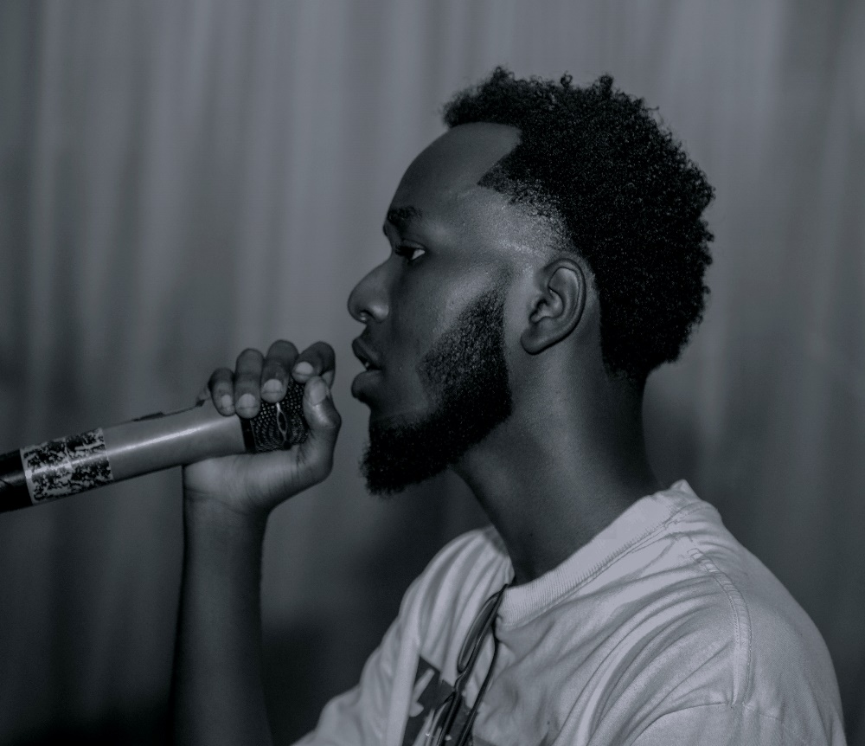
Personal Introduction: IRADUKUNDA SHEMA Jean Serge https://www.linkedin.com/in/iradukunda-shema-jean-serge-345927329/
Name:
IRADUKUNDA SHEMA Jean Serge
Concentration:
IT Software Engineering
Year:
2nd Year
Where You Are From:
Kigali, Rwanda
Use of Digital Information:
I utilize digital tools for coding, project management, and online collaboration with peers. I also engage in online courses to enhance my skills.
Expectation to the Course:
I hope to gain practical knowledge and skills that will prepare me for a successful career in software development.
What They Do Not Know About Me:
I am an artist, songwriter, and composer, which allows me to express my creativity in unique ways.

